Slide 1
Social Categorisation & Racism
Stereotypes, Prejudice, Discrimination

Slide 2
Recap: Attitude Components
Attitudes have 3 parts:
    Affective – emotional reactions towards attitude object
    Cognitive – thoughts and beliefs about attitude object
    Behavioral – actions towards attitude object
Attitudes change spontaneously – usually due to social influence

Slide 3
Values
These are conceptions of desirable end states that reflect what is important to us in our lives
(Feather, 1990, 1995; Schwartz & Bilsky, 1987, 1990)
For example: You may value equality and social justice.
You live up to these values is by behaving in ways that express them—such as by devoting time to improve the life of others.

Slide 4
Stereotypes
Social Psychology
Stereotypes: are inaccurate generalisations that are harmful for the following reasons:
    Reduce one’s ability to treat another as individual as an individual.
    Narrow expectations for behaviour of others
    Lead to faulty attributions.
    Can also cause a generalised (sometimes accurate, but often overgeneralised) belief about a group of people
  **Attitudes lead to behaviours!!

Slide 5
Stereotyping – case study
Jane Elliott’s study of prejudice (blue eyes-brown eyes)
  Brown eyed children told they were better, smarter, given privileges;
  Brown eyes assumed superior attitude; blue eyes started to perform poorly
** Shows how quickly stereotypes start shaping attitudes & behaviour
psychlotron.org.uk

Slide 6
Prejudice
Prejudice
It is an unjustifiable (and usually negative) attitude toward a group and its members, based on inaccurate generalisations
  involves stereotyped beliefs, negative feelings, and a predisposition to discriminatory action.
Prejudice is an attitude, usually negative, towards members of a group based on their membership of that group (e.g., gender, race, religion). It involves a prejudgement of a group and includes feelings, such as contempt.

Slide 7
Components of Prejudice
Beliefs (stereotypes)
Predisposition to act (to discriminate)
Emotions (hostility, envy, fear)

Slide 8
Why does prejudice arise?
Social Inequalities - Prejudice develops when people have money, power, and prestige, and others do not. Social inequality increases prejudice.
Social Divisions - Ingroup: People with whom one shares a common identity. Outgroup: Those perceived as different from one’s ingroup. Ingroup Bias: The tendency to favor one’s own group. One way we simplify our world is to categorize. We categorize people into groups by stereotyping them.
Emotional Scapegoating/roots - Prejudice provides an outlet for anger [emotion] by providing someone to blame. After 9/11 many people lashed out against innocent Arab-Americans.
Notes:
OBJECTIVE 15| Discuss the social factors that contribute to prejudice.

Slide 9
Causes of Stereotypes and Prejudice
Social Psychology
  Automatic prejudice – everyone is prejudiced about something
  Realistic conflict - caused by social processes occurring between groups of people. It is the frustration from competing with another group for scarce resources
  Social learning - prejudice is taught and learned.
  Social identity theory - It is the way our sense of self (identity) is determined by the groups we belong to. Us versus them mentality; the human tendency of in-group and out-group

Slide 10
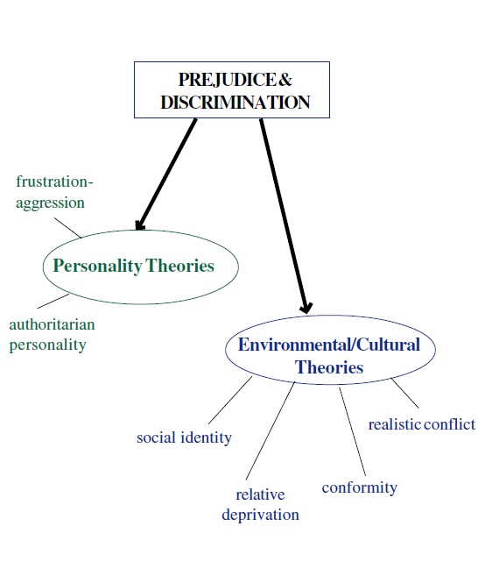


Slide 11
Combating prejudice:
Social Psychology
  Recognise prejudice
  Control automatic prejudice
  Increase contact among prejudiced groups
    Two groups must be almost equal in status
    View each other as typical of their respective group; not the exception
    Engage in cooperative, not competitive tasks
    Contact must be informal

Slide 12
Reducing Prejudice
INTERGROUP CONTACT BY:
Contact Hypothesis (Allport, 1954) - This proposes that prejudice is reduced if there is increased contact between two groups since such contact can: disprove stereotypes, and help people to recognise the similarities between groups.
Common goals - This extends the contact hypothesis proposing that in addition to intergroup contact, co-operation between groups to achieve common goals is needed to reduce prejudice.
Decategorisation - This variation of the intergroup contact hypothesis applies social identity theory.
For intergroup contact to be successful in decreasing prejudice, the boundaries between the groups needs to become blurred so that people are more likely to view members of the other group as individuals rather than
Recategorisation - Like decategorisation, this also applies social identity theory. Gaertner et al. (1993) propose that the process of recategorisation is more effective than decategorisation. Instead of blurring group boundaries, the two groups are recategorised into one new superordinate category.

Slide 13
Reducing Prejudice
SOCIAL EDUCATION BY:
Experiencing Prejudice - This approach is based on the assumption that experiencing prejudice and finding out how unpleasant it is will reduce our prejudicial behaviour.
Self-regulation/education - Monteith (1993) proposes that we all hold negative stereotypes which are activated automatically when we meet someone. This in turn may lead to prejudicial behaviour. We therefore need to be made aware of the stereotypes we hold so that we can self-regulate our thoughts and feelings.

Slide 14
Discrimination
Discrimination is a negative behaviour or action (e.g., aggression) directed at members of a group based on a prejudice.
It is the treatment or consideration of, or making a distinction in favour of or against, a person or thing based on the group, class, or category to which that person or thing is perceived to belong to rather than on individual merit.
Note: prejudice and discrimination are not interchangeable; they refer to different things. Prejudice and discrimination do not always occur together. It is possible to be prejudiced to others without openly behaving in a hostile way.

Slide 15
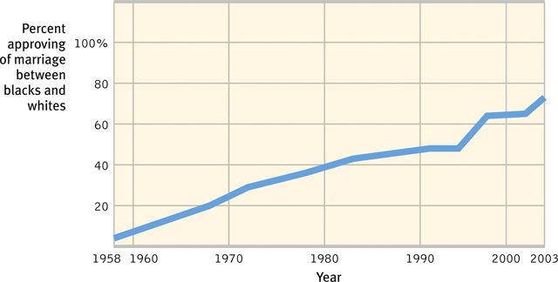
How Prejudiced are People?
Over the duration of time many prejudices against interracial marriage, gender, homosexuality, and minorities have decreased.
Notes:
OBJECTIVE 14| Contrast overt and subtle forms of prejudice, and give examples of each.

Slide 16
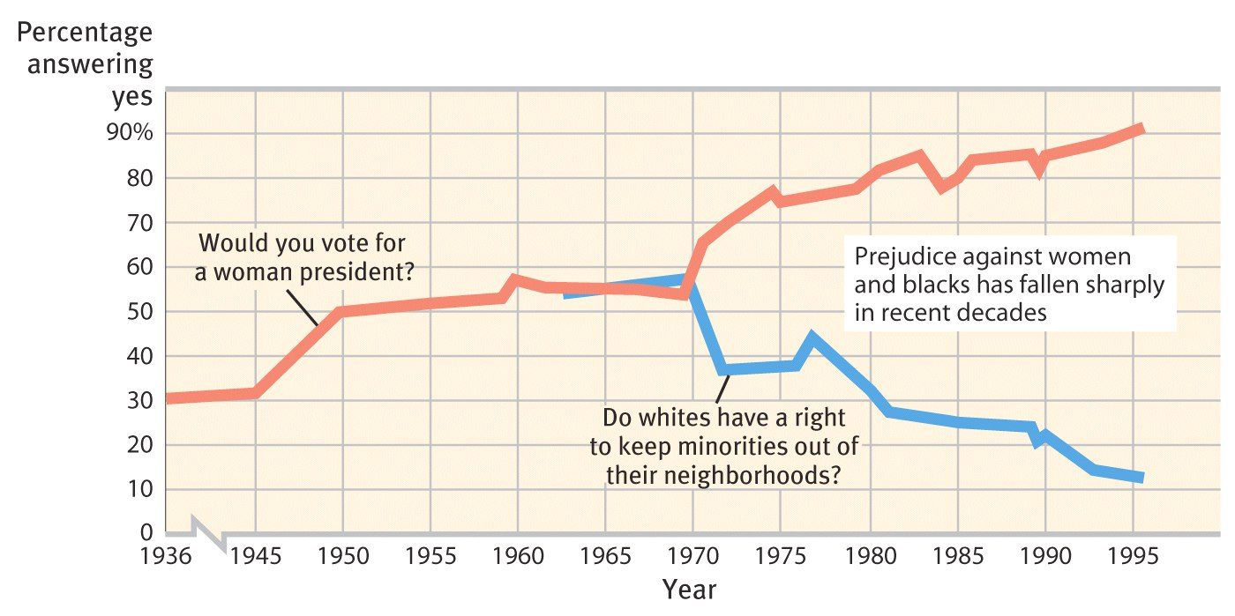
Racial & Gender Prejudice
Americans today express much less racial and gender prejudice, but prejudices still exist.

Slide 17
Racial & Gender Prejudice
Race - Nine out of ten white respondents were slow when responding to words like “peace” or “paradise” when they saw a black individual’s photo compared to a white individual’s photo (Hugenberg & Bodenhausen, 2003).
Gender - Most women still live in more poverty than men. About 100,000,000 women are missing in the world. There is a preference for male children in China and India, even with sex-selected abortion outlawed.

